Slide 1
OBESITY LEVEL PREDICTION
DATA VISUALIZATION
(CSE3020)
TEAM MEMBERS
Shrikumaran PA - 20BCE1082
Renil Augustine Baby - 20BCE1826
Anu Cyril Saju - 20BCE1923

Slide 2
ABSTRACT
In modern times, obesity has become a significant threat all over the world. People are constantly moving towards an unhealthy lifestyle, eating excessive junk food, late-night sleep, spend a long time sitting down. It promotes the spread of complex illnesses, stroke, heart disease, liver cancer.
For this analysis, we use a dataset which contains 17 attributes, and we visualize the impact of each attribute on obesity and finally predict the obesity level.
We have used machine learning classification algorithms like Naïve Bayes, logistic regression, decision tree and random forest to predict the obesity level of an individual given his lifestyle attributes.

Slide 3
DATASET
The data contains 17 attributes and 2111 records, the records are labeled with the class variable NObesity (Obesity Level), that allows classification of the data using the values of Insufficient Weight, Normal Weight, Overweight Level I, Overweight Level II, Obesity Type I, Obesity Type II and Obesity Type III.
The attributes related with eating habits are: Frequent consumption of high caloric food (FAVC), Frequency of consumption of vegetables (FCVC), Number of main meals (NCP), Consumption of food between meals (CAEC), Consumption of water daily (CH20), and Consumption of alcohol (CALC).
The attributes related with the physical condition are: Calories consumption monitoring (SCC), Physical activity frequency (FAF), Time using technology devices (TUE), Transportation used (MTRANS), other variables obtained were: Gender, Age, Height and Weight.

Slide 4
ALGORITHMS USED
Naïve Bayes
Logistic Regression
Decision Tree
Random forest
K means clustering

Slide 5
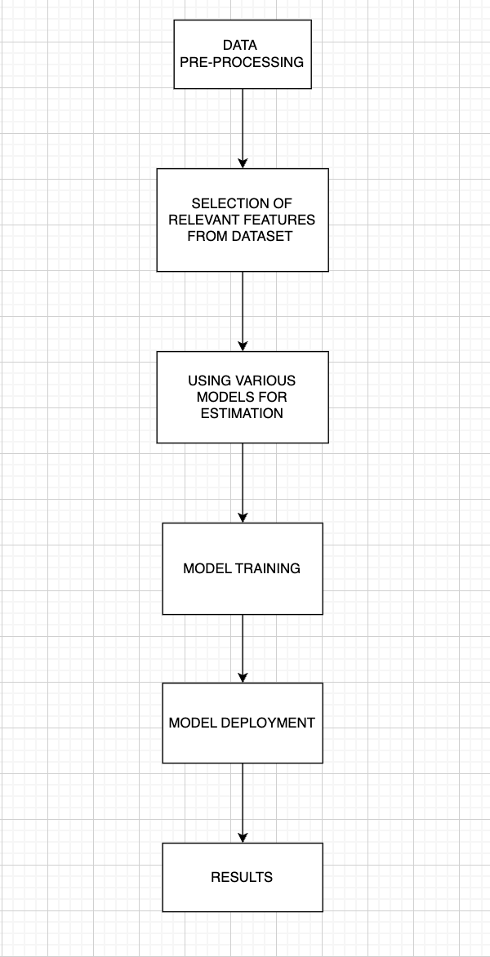
ARCHITECTURE

Slide 6
MODEL RESULTS
Accuracy of classification algorithms:
Naive Bayes: 63.61%
Logistic Regression: 95.73%
Decision Tree: 86.71%
Random Forest: 96.84%
Random forest gave best results since it generated 500 trees for classification.
Hence random forest is used for predicting the obesity level.

Slide 7
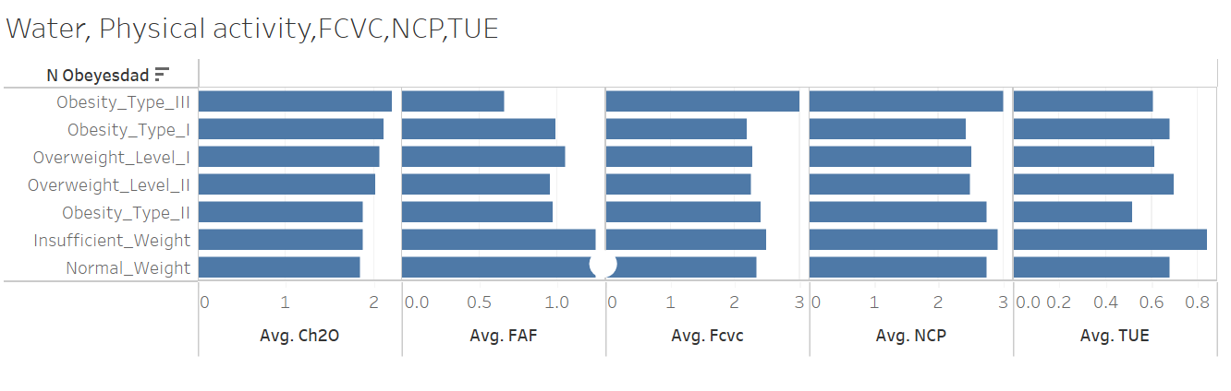
TABLEAU VISUALIZATIONS
1) Relation between consumption of water, physical activity, frequent consumption of vegetables, number of main meals, and time using technology against obesity levels

Slide 8
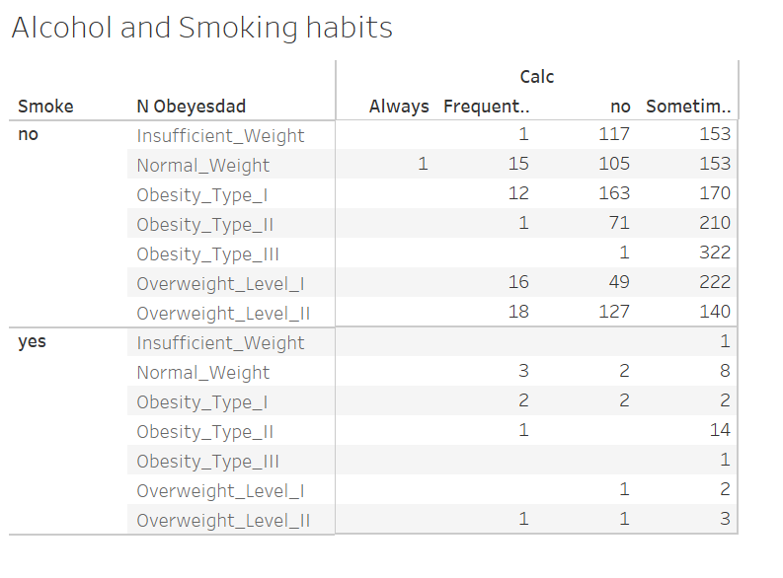
2) Alcohol and smoking habits vs obesity levels

Slide 9
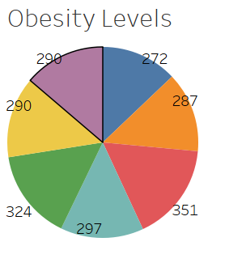
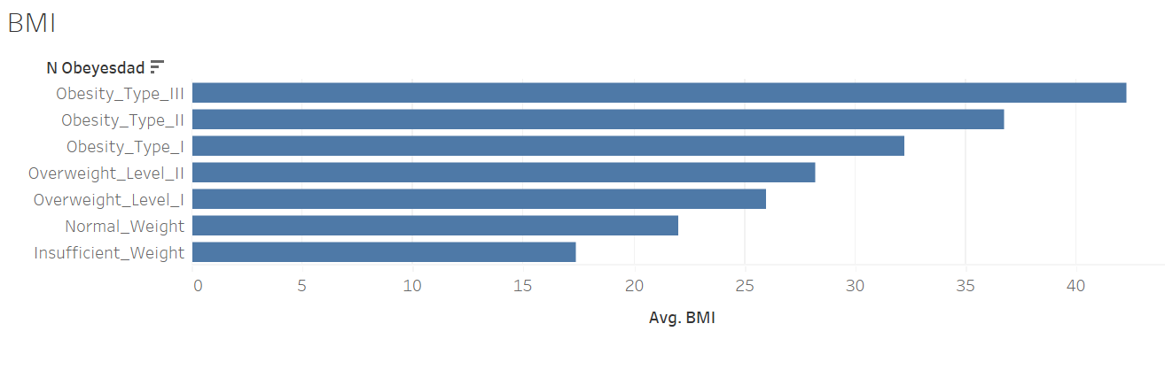
3) Distribution of various obesity levels in the dataset
4) BMI vs obesity levels

Slide 10
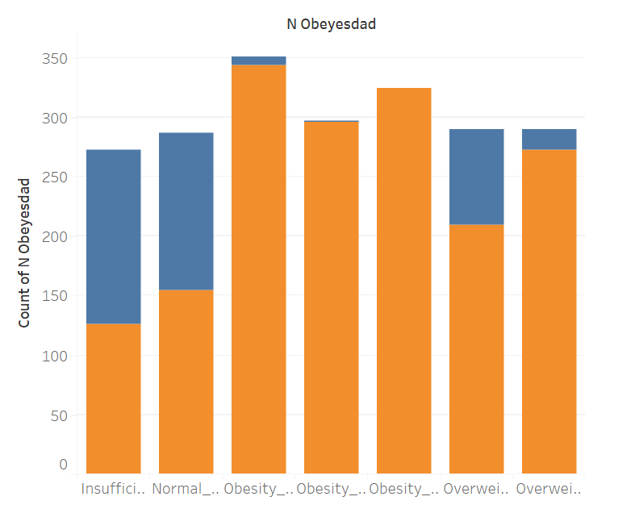
5) Effect of family history in obesity

Slide 11
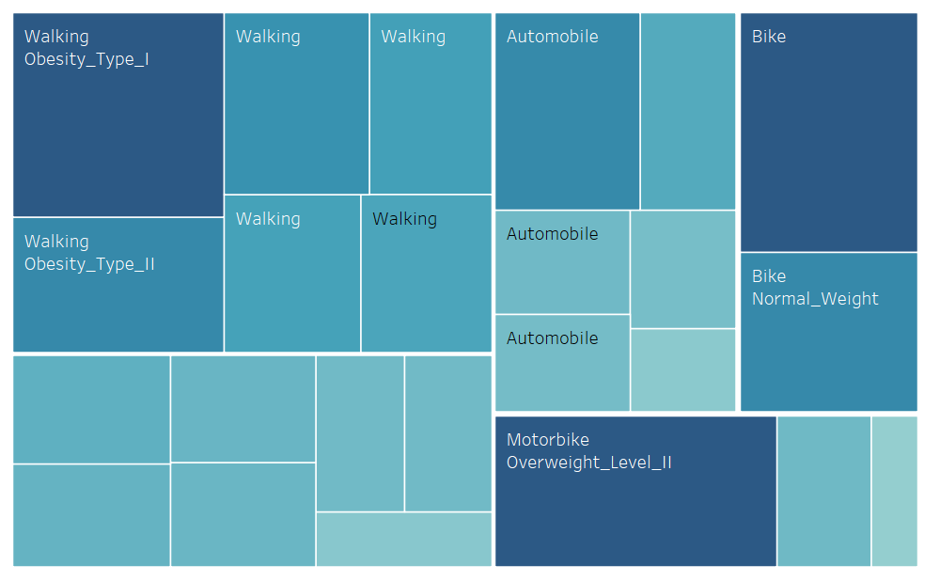
6) Transportation and Physical activity vs Obesity level

Slide 12
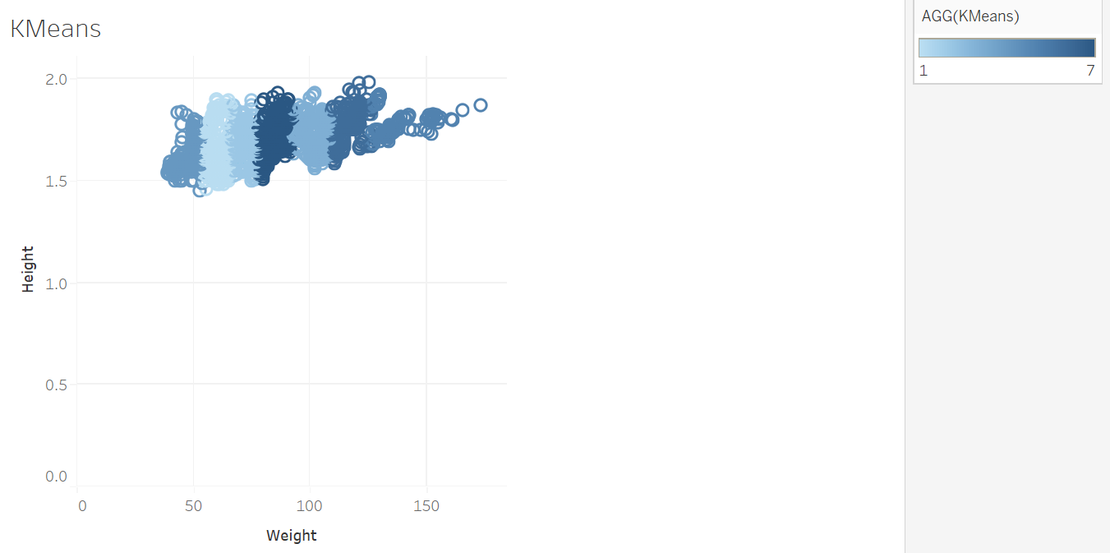
7) K Means Clustering

Slide 13
RESULTS AND CONCLUSIONS
We can see that more than 93% people with overweight and obesity also have a family history of people with overweight.
We can also see that when a person smokes or drinks alcohol, they lose their appetite which leads to them having a much lower obesity risk compared to those who don't drink or smoke.
While genetics can contribute to the development of obesity, it is not the only factor at play. Environmental factors such as diet, physical activity, and lifestyle choices also play a significant role in the development of obesity.

Slide 14
THANK YOU

